Slide 1





Air Quality Analysis
A Data-Driven Analysis Using Weather and Pollution Data

Slide 2
Arphaxad Nguka
01
02
03
04
05
06
Introduction
Executive summary
Objectives
Situation/Problem
Case Assessment
Data driven solutions
Monitoring, explanatory analytics, and predictive modelling to support environmental decision-making
Monitoring AQI
Prediction
Conclusion
Baseline Conditions
Pollution comparisons
Clustering weather regimes
Air Quality Prediction
Actionable insights, enabling environmental monitoring, risk assessment, and data-driven decision- making

Slide 3

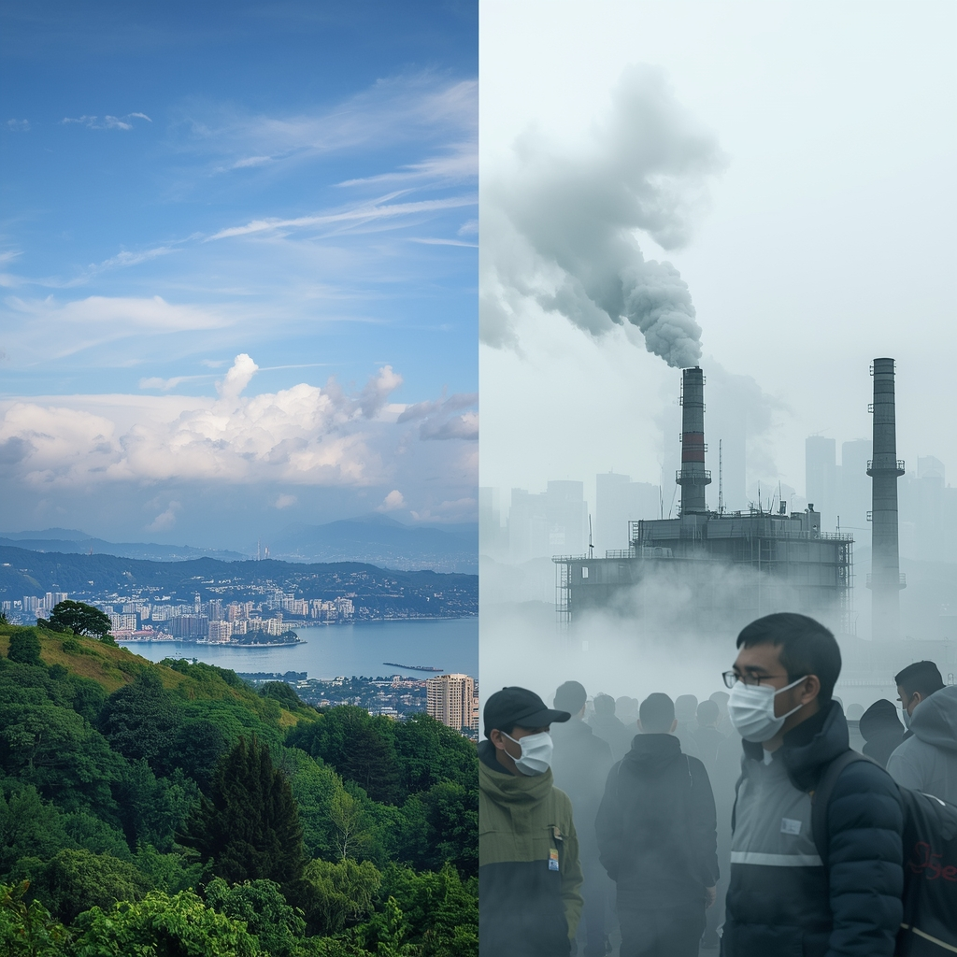

01
Introduction
Business Problem / Situation

Slide 4
EXECUTIVE SUMMARY
Key Findings at a Glance
Los Angeles has the worst air quality (AQI: 80.2)
Cleveland has the best air quality (AQI: 35.4)
2.3x difference in pollution levels between highest and lowest
All cities have 60 days of consistent data collection
Temperature varies widely (-0.2°C to 16.9°C)

Slide 5
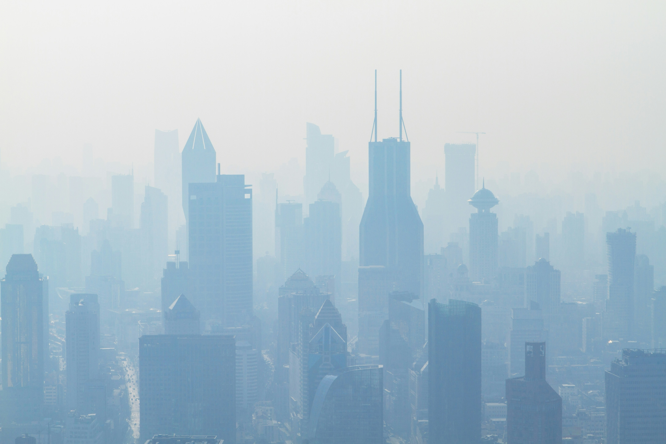
Air pollution poses increasing risks to public health, urban productivity, and regulatory compliance.
Organisations of concern are responsible for:
Environmental regulation,
Urban planning,
Public health, and
Infrastructure operations
There is a need for an evidence-based understanding of the weather's influence on air quality.
Clear, interpretable dashboards that translate environmental data into operational decisions

Slide 6
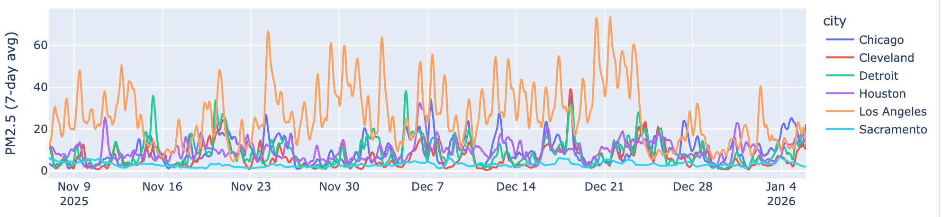
Monitoring and Situational Awareness
6 Cities
USA
Air quality parameters
pm2_5
Carbon monoxide
Sulphur dioxide
ozone
USA AQI
Carbon dioxide
Nitrogen dioxide
Weather forecast variables
Temperature,
relative humidity,
Precipitation,
wind speed and
surface pressure

Slide 7
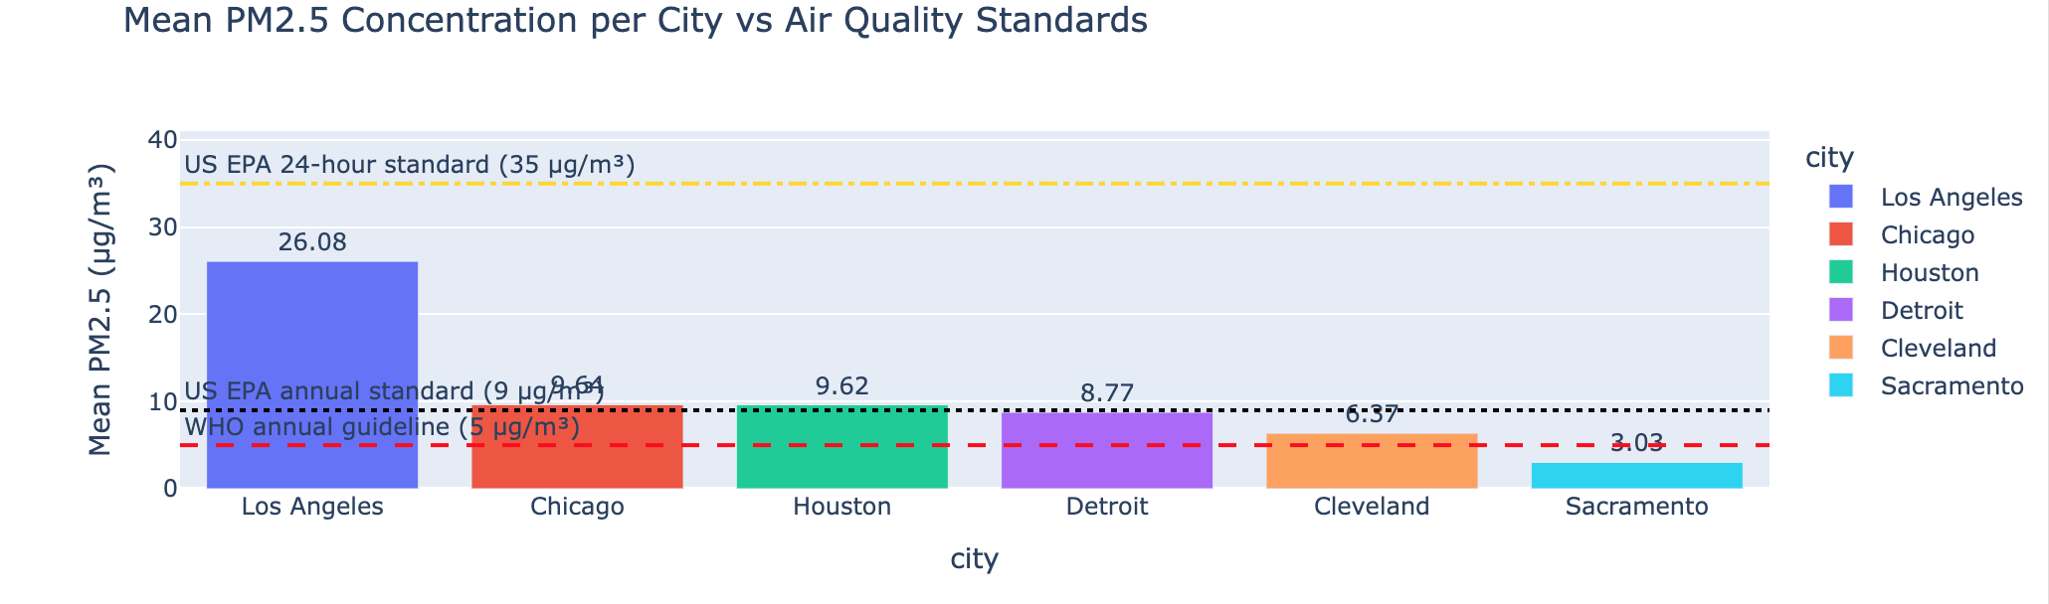
Spotlight:
The Clean Air Champion Cleveland
Pollution hotspot
Los Angeles
Critical Finding:
PM2.5 is 4x higher than Chicago/Houston
PM2.5 is 8.7x higher than Sacramento!
Despite similar temperatures to other cities
AQI: 35.4 (Lowest)
• PM2.5: 6.4 µg/m³
• Temperature: 1.1°C
• Days: 60

Slide 8
Regional Comparison
WEST COAST ══════════════════ • Los Angeles: 80.2 AQI (High pollution) • Sacramento: 39.3 AQI (Low pollution)
SOUTH ══════════════════════ • Houston: 40.3 AQI
Moderate
No clear geographical trend
GREAT LAKES ══════════════════════ • Chicago: 41.1 AQI • Cleveland: 35.4 AQI (Best) • Detroit: 38.8 AQI

Slide 9

DATA COLLECTION • 6 US cities • 60 consecutive days • Daily measurements METRICS TRACKED • Air Quality Index (AQI) • PM2.5 concentration • Temperature • Statistical averages ANALYSIS APPROACH • Comparative analysis • Ranking methodology • Pattern identification
How the data was analysed

Slide 10
Key takeaways
Pollution isn't predictable by location or temperature
Los Angeles stands out as a serious concern
Sacramento excels in PM2.5 control (3.0 µg/m³)
60-day consistency shows reliable patterns, not anomalies
Multiple factors beyond temperature affect air quality

Slide 11
Future Analysis Directions
Immediate Actions:
Investigate LA's unique pollution sources
Study Sacramento's successful PM2.5 management
Expand to more cities and longer timeframes
Advanced Analysis:
Weather pattern correlation
Economic/industrial factors
Seasonal variation study
Policy effectiveness assessment

